Slide 1

Year 4 Multiplication Tables Check 2026

Slide 2
Important information about multiplication tables check (MTC)
The MTC determines if Year 4 children can fluently recall their multiplication tables.
They are designed to help schools identify which children require more support to learn their times tables.
There is no ‘pass’ rate or threshold which means that, unlike the Phonics Screening Check, children will not be expected to re-sit the check.
The Department for Education (DfE) will create a report about the overall results across all schools in England, not individual schools.
Notes:
The test is designed to identify pupils who need support, not as a diagnostic tool to assess the times tables children struggle with.
https://www.gov.uk/government/collections/multiplication-tables-check

Slide 3
When the check will take place
There will be a 2 week window from Monday 1st June 2026 for schools to administer the check.
There is no set day to administer the check and children are not expected to take the check at the same time.
All eligible Year 4 children in England will be required to take the check.
Notes:
It is up to individual schools to decide how the check is administered – some schools will administer individually while others will take small groups out or administer to the whole class.
A list of pupils who should not take the test can be found in the administration guidance of the MTC documentation.

Slide 4
How the check is carried out
The check will be fully digital.
Answers will be entered using a keyboard, by pressing digits using a mouse or using an on-screen number pad.
Usually, the check will take less than 5 minutes for each child.
The children will have 6 seconds from the time the question appears to input their answer.
There will be a total of 25 questions with a 3 second pause in-between questions.
There will be 3 practice questions before the check begins.
Notes:
Some children will be eligible for additional support (detailed in the next slide).
6 seconds per answer means that children must be able to read, recall and enter their response within that time. Whatever is written in the answer box at the end of 6 seconds will be counted as the answer i.e. if the student intends to write 144 and only 14 is typed when the timer ends, their recorded answer is 14.
Children are allowed to practise before taking the check.
https://mathsframe.co.uk/en/resources/resource/477/Multiplication-Tables-Check example showing how quick the questions are/ types of questions.

Slide 5
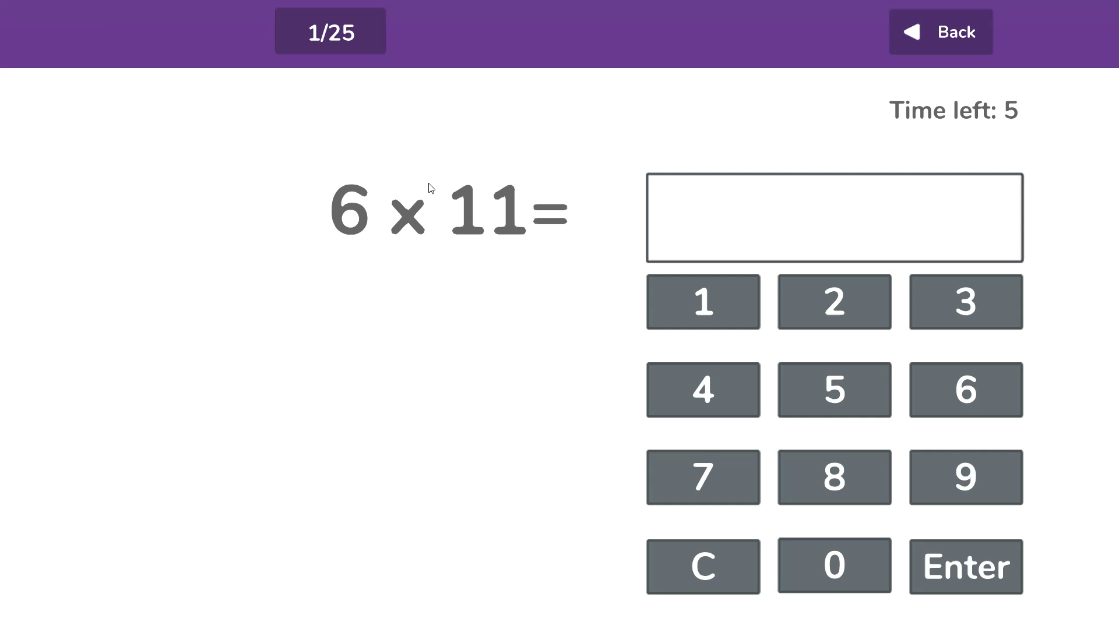

Slide 6
Specific arrangements for the check
Some children will be eligible for specific arrangements:
Colour contrast;
Font size adjustment;
‘Next’ button (alternative to 3-second pause);
Removing on-screen number pad;
An adult to input answers;
Audio version;
Audible time alert.
Notes:
Children eligible for access arrangements are:
Children with an EHC plan
Children who have provisions made in school using the SEND support system.
Children with behavioural, emotional or social difficulties
Children with EAL
Schools do not need to request permission to use access arrangements. The support should be based on the support provided in school and should not advantage or disadvantage individual children.
A child can be assigned more than one access arrangement, if required.
There is no opportunity for additional time.

Slide 7
The check questions
Each child will be randomly assigned a set of questions
There will only be multiplication questions in the check, not division facts.
The 6, 7, 8, 9 and 12 times tables are more likely to be asked.
Reversal of questions (e.g. 8 x 6 and 6 x 8) will not be asked in the same check.
Children will not see their individual results when they complete the check.
Notes:
Some questions will be repeated across different checks, but no more than 30% of questions will be repeated in any two checks. This means that if the check gets interrupted and children need to re-start it, they will only have a minimal advantage.
During the check pupils may be able to restart if certain conditions are met (e.g. a fire alarm).
The results will be sent to the schools when all the checks have been completed but it is then up to the school if they report the results or not.
There won’t be questions from the 1 times tables (although they might be included in the 3 practice questions).
There will be a maximum of 7 questions from the 2, 5 and 10 times tables.
There is a focus on the 6, 7, 8, 9 and 12 times tables as they are the ‘most difficult’ multiplication tables.

Slide 8

More information about the questions
The Standards and Testing Agency (STA) state that they are classifying the multiplication tables by the first number (multiplier) in the question. For example, 8 x 3 would fall within the 8 times table.
Notes:
The table shows the minimum/ maximum number of questions from each times table that will be asked.

Slide 9

What if my child does not achieve full marks in the MTC?
The MTC will serve as a measure of how well children understand and can recall their times table knowledge.
Times tables are vital to the Year 5 and Year 6 curriculum and gaps in their knowledge will hold them back when completing work in Years 5 and 6.
Any child who does not achieve full marks in the MTC will receive further additional support in the form of interventions to plug any gaps in their times table knowledge in Years 5 and 6.
The MTC will serve as a helpful tool for teachers and schools in identifying children with gaps in their mathematical knowledge.

Slide 10
What are we doing to prepare children in school?
Times tables are taught at least twice weekly as part of your child's maths lessons.
Children particularly in Years 3 and 4 practice the 'Multiplication Tables Check’ using Mathsframe and are encouraged to practice their tables against a clock.
Teachers test times tables weekly to check where pupils are up to.
Any children who are not secure with their times tables at different stages of the year receive interventions to help them catch up.

Slide 11
How can you help at home?
Encourage your child to actively use Mathsframe or Purple Mash. They can access this from a desktop computer or a tablet.
Quiz your children regularly and at random on their times tables. This could be done whilst cooking tea together, during car journeys or on the walk to school.
Listen to online times tables songs or raps – many can be found on Youtube.
Use times table wall charts at home.
Create flashcards with your child for each times table and play games like snap or matching them up in specific time.
Support school in any times table practice we send home.

